Slide 1
Introduction to Data Visualization with R using ggplot2
Richard Johansen

Slide 2
Workshop Agenda
Workshop Expectations
Understanding Data
Visualizations
The Scenario
Why R and ggplot2?

Slide 3
Workshop Agenda
Workshop Expectations
Understanding Data
Visualizations
The Scenario
Why R and ggplot2?

Slide 4
Workshop Expectations
Assumptions:
You have some basic coding experience or familiarity with a coding environment
You have some general data visualization knowledge (i.e. What is a scatter plot)
Prerequisites:
R and R studio Installed
Install the ggplot2 package
Caveat
This is only a simple introduction to data visualization with R & ggplot2
We cannot cover everything but we will cover many of the common aspects you will use the majority of the time
Goal
Conduct basic data exploration and data visualization
Allow you to (re)produce print-quality graphics in seconds

Slide 5
Workshop Agenda
Workshop Expectations
Understanding Data
Visualizations
The Scenario
Why R and ggplot2?

Slide 6
What is Data?
Data is a collection of objects defined by attributes
An attribute is a property or characteristic of an object
Examples: eye color of a person, temperature, etc.
Synonyms: variables, fields, characteristics, features, columns, etc.
A collection of attributes describe an object
Synonyms: records, points, cases, samples, instances, rows, etc.

Slide 7
Attribute Values
Each attribute has a potential set of values objects draw from.
The same attribute can be mapped to different attribute values
Example: height can be measured in meters or feet
Different attributes can be mapped to the same set of values
Example: Attribute values for ID and age are both integers

Slide 8
Attribute Classification
Discrete Attribute – has a infinite or countably infinite set of values
Examples: zip codes, number of words,
Typically represented as integers
Continuous Attribute - has real numbers as attribute values
Example: temperature, height, weight
Typically represented as floating point (decimal)

Slide 9
Important Attribute Classes
Categorical
Nominal - Data that can be counted, but not aggregated or ordered
Examples: Eye Color, Zip Code, Music Genre
Ordinal - Data that can be counted and ordered, but not aggregated.
Examples: Grades, Clothing Size, Positions (in a race)
Numerical
Interval (metrics) - The difference in values are constant and meaningful
Examples: The difference between a temperature of 100°F and 90°F is the same difference as between 90°F and 80°F.
Ratio - An interval scale with an absolute zero
Examples: Income, Height, Weight

Slide 10
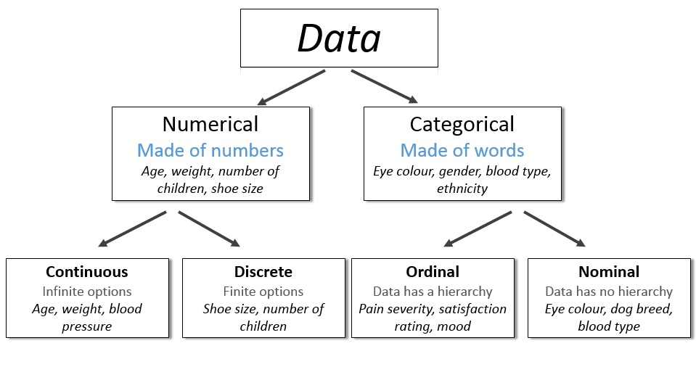
http://survivestatistics.com/variables/

Slide 11

Data Set Classification
Record
Data Matrix
Document Data
Transaction Data
Graph
World Wide Web
Molecular Structures
Ordered
Spatial Data
Temporal Data
Sequential Data

Slide 12
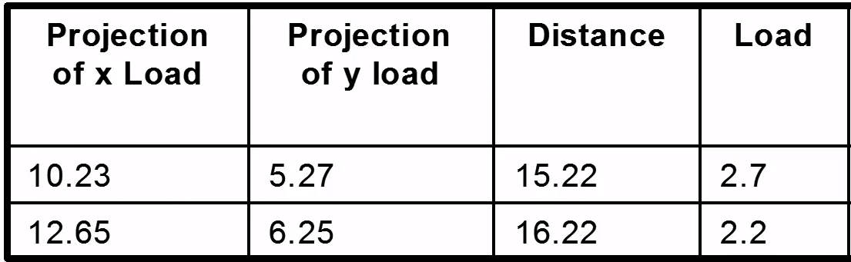
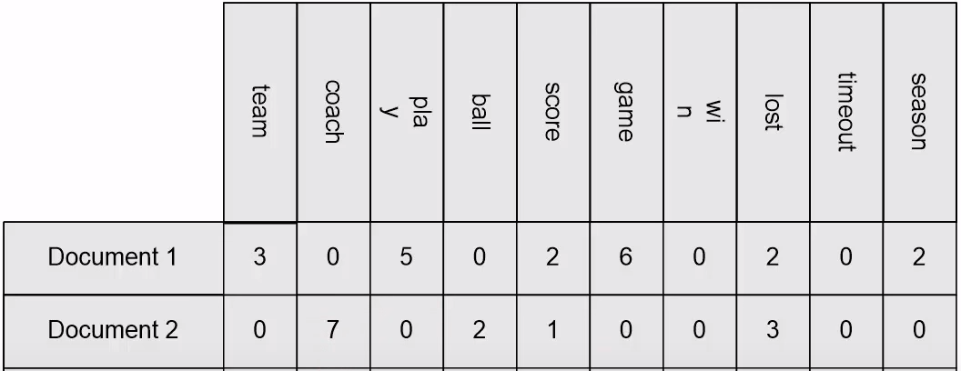
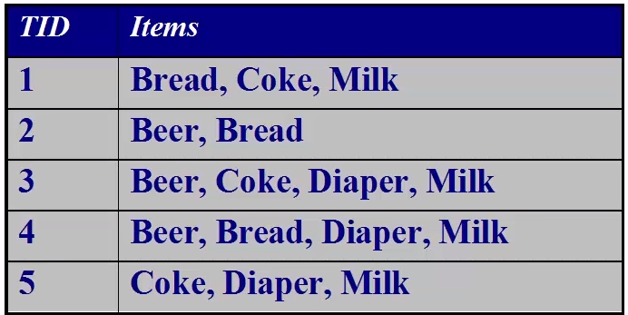
Record Data
Data that consist of a collection of records, each which consists of a fixed set of attributes (Tables)
Data Matrix – Entirely continuous numerical data
Can be plotted in multi-dimensional space (each dimension is an attribute)
Document Data – Each object is a “term” vector (count)
Transaction Data – Each record is a set of items (transactions)

Slide 13
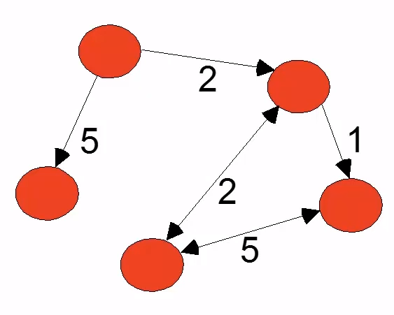
Graph Data
World Wide Web
Nodes, Edges, Direction, Weight
Molecular Structures

Slide 14
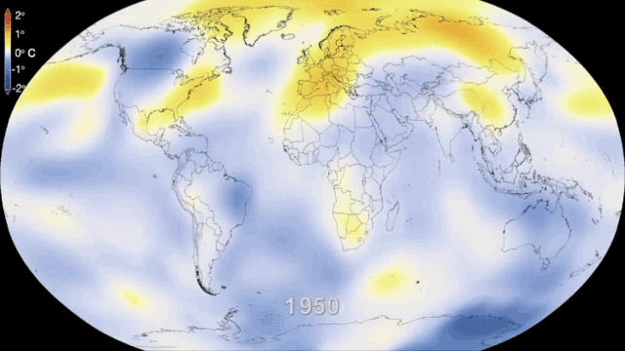
Ordered Data
Spatial and Temporal Data
Global Temperature
Sequential Data
Genetic Sequence
GAGAAGGCCTTCCC
https://www.albert.io/learn/ngss-earth-space-sciences/hsess36-anthropogenic-impact-on-systems/analyzing-human-contributions-to-carbon-dioxide-levels-and-ocean-acidification/global-temperature-and-carbon-dioxide-levels?page=1

Slide 15
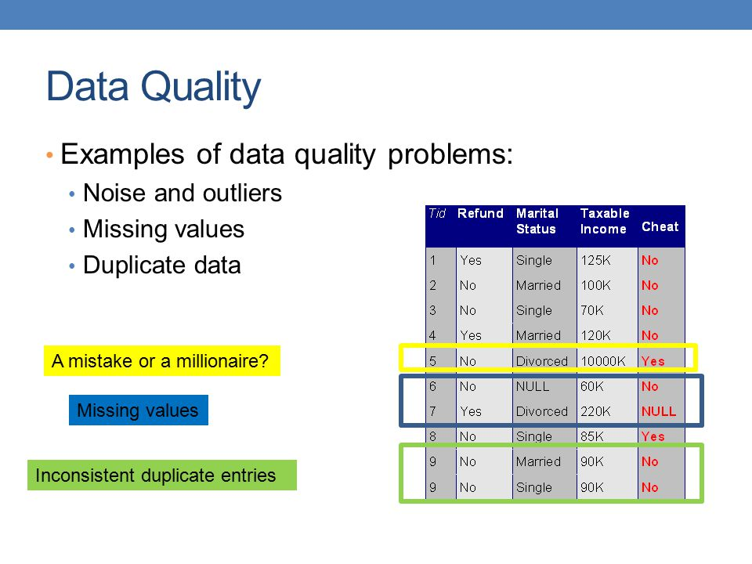
Data Quality
Main Issues with Data Quality:
Noise and Outliers
Missing Values
Duplicate Data
Data Preprocessing Exploratory Analysis Post-processing Published byMilo Cunliffe

Slide 16
Primitive Data Types
Boolean:
True (T) or False (F)
Char:
Characters and Strings – “A”, “Beta”, “There are different data types!”
Factors:
Ordinal Data – 1st, 2nd, 3rd Or High, Medium, Low
Int:
Integers – (1, 2, 100)
Float/Double:
Decimal – (0.1, 0.2, 0.1352)

Slide 17
Workshop Agenda
Workshop Expectations
Understanding Data
Visualizations
The Scenario
Why R and ggplot2?

Slide 18
What is Data Visualization
“Visualization transforms data into images that effectively and accurately represent information about the data.”
–Schroeder et al. The Visualization Toolkit, 2nd ed. 1998
“Data graphics visually display measured quantities by means of the combined use of points, lines, a coordinate system, numbers, symbols, words, shading, and color.”
–Edward Tufte The Visual Display of Quantitative Information (2nd Ed.)

Slide 19
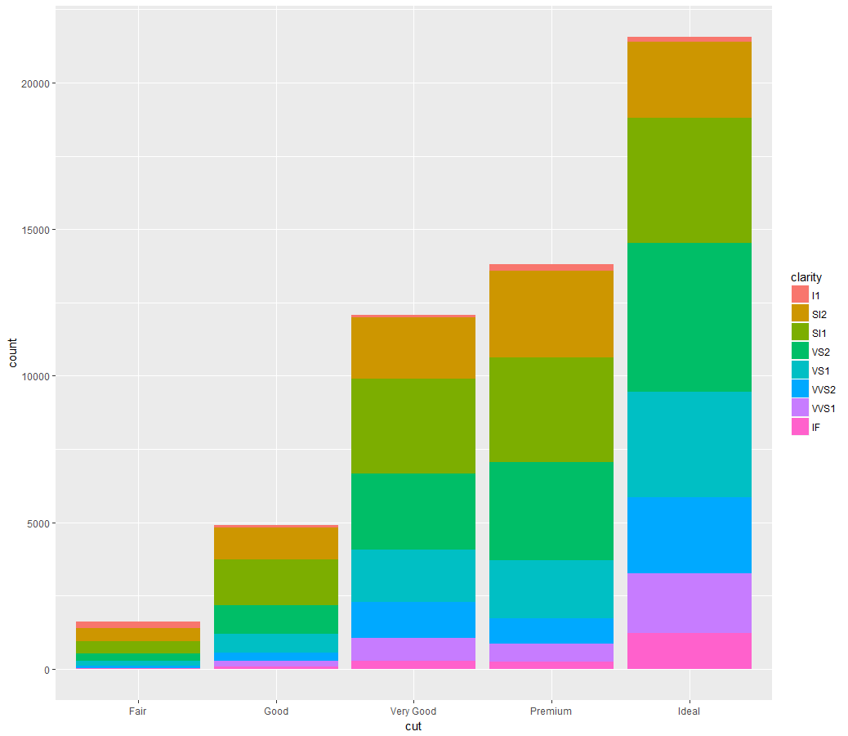
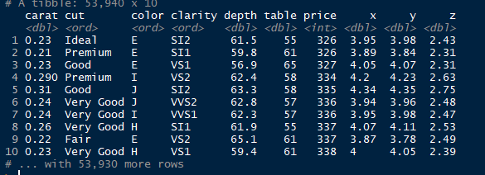
Why is Data Visualization Important?

Slide 20
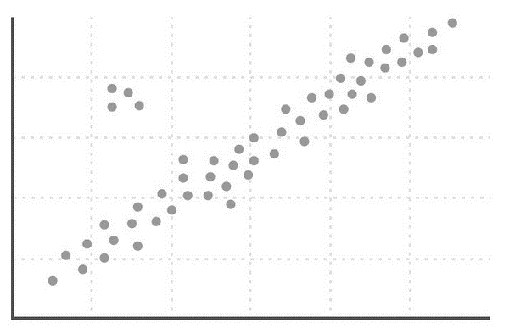
Why Do Visualization
Reasons for doing data visualization
Exploration
Use visualizations as a means of data exploration
Analysis
Verify (or Falsify) a hypothesis
Presentation
Visualization is used to communicate results or findings

Slide 21
Why Do Visualization
Reasons for doing data visualization
Exploration
Use visualizations as a means of data exploration
Analysis
Verify (or Falsify) a hypothesis
Presentation
Visualization is used to communicate results or findings

Slide 22

Why Do Visualization
Reasons for doing data visualization
Exploration
Use visualizations as a means of data exploration
Analysis
Verify (or Falsify) a hypothesis
Presentation
Visualization is used to communicate results or findings

Slide 23
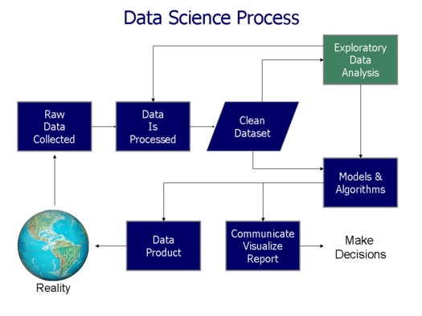
Data Science Process
Acquire Data
“Know your data”
Clean and Pre-Process
Visualize (explore)
Model/Analyze
Communicate Findings/ Data Production
https://commons.wikimedia.org/wiki/File:Data_visualization_process_v1.png
Notes:
Jennifer

Slide 24
Chart Types
Common Chart Types
Comparison - comparing and sorting data points;
Composition - part-to-whole comparisons;
Distribution - comparison of data points along an axis;
Relationship - relationship patterns between two or more variables;

Slide 25
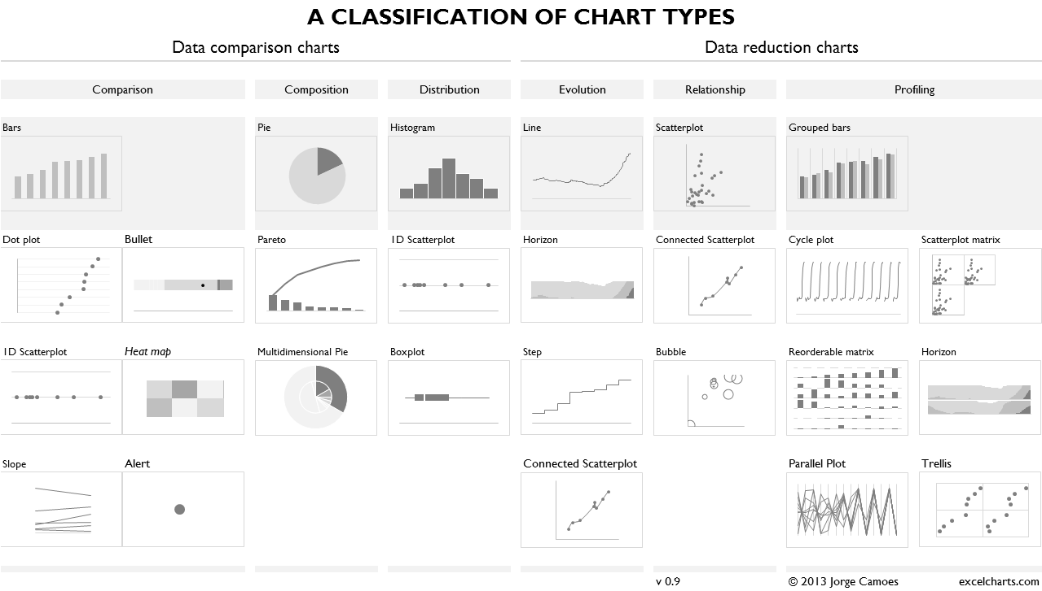
https://excelcharts.com/classification-chart-types/

Slide 26
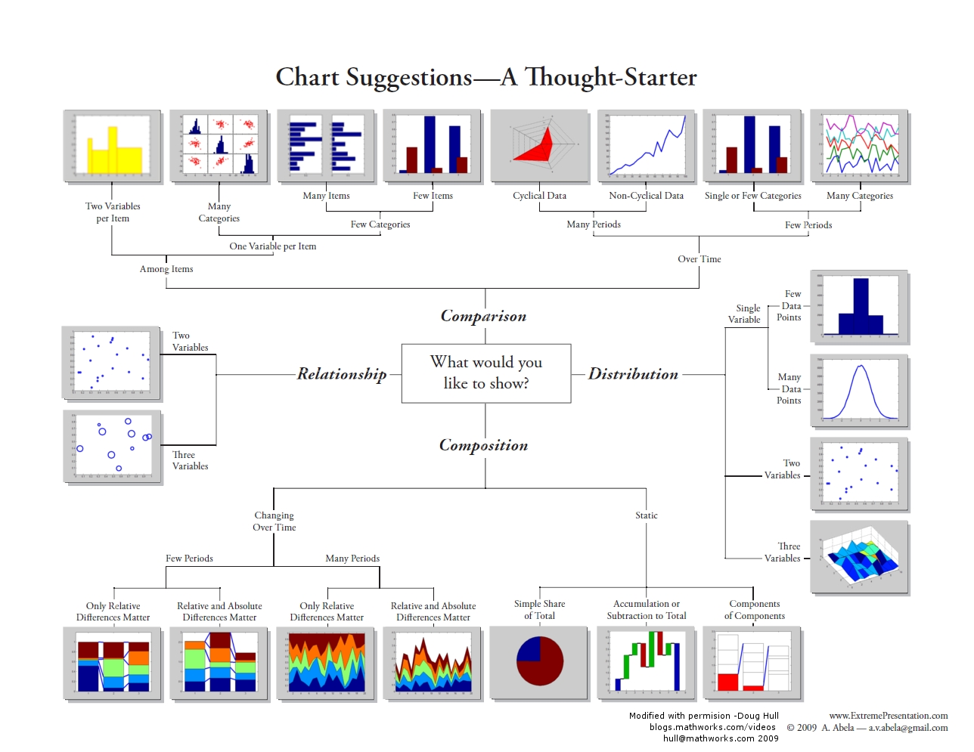
https://datavizblog.files.wordpress.com/2013/04/andrew-abela-chart-chooser-in-color.jpg

Slide 27
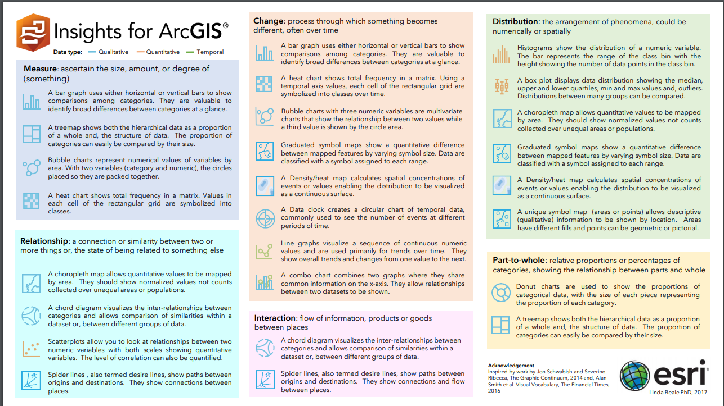
https://assets.esri.com/content/dam/esrisites/media/pdf/insights-for-arcgis/Data%20Vizualization%20Options%20in%20Insights.pdf

Slide 28
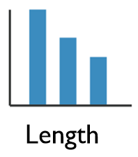
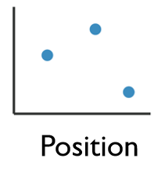
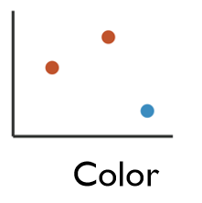
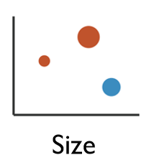
Enhancing Visualizations
1 Dimensional Data
Length
2 Dimensional Data
Position
2+ Dimensional Data
Position
Color Hue/Saturation
Size
Shape

Slide 29
Workshop Agenda
Workshop Expectations
Understanding Data
The Scenario
Visualizations
Why R and ggplot2?

Slide 30
Titanic Data Set
We will use the Kaggle Competition’s Titanic Machine Learning from Disaster Dataset
Everyone is familiar with the Titanic
The data set is a good representation of real world data
Following the teaching model from Dave Langer’s presentation on Data Science Dojo

Slide 31
Titanic Data Dictionary
Variables:
Survival – Survival (yes=1, no=0)
Pclass – Ticket Class (1st class, 2nd class)
Sex – Gender (Male or Female)
Age – Passenger age
Sibsp – # of Siblings/Spouse
Parch – # of Parents/Children
Ticket – Ticket Number
Fare – Passenger Fare
Cabin – Cabin Number
Embarked – Port of Embarkation

Slide 32
Your Job
You are hired as a consultant and have been tasked with analyzing the titanic data set.
Your goal is to explore patterns and trends to explain what influenced the survival rate of the passengers on the Titanic.

Slide 33
Workshop Agenda
Workshop Expectations
Understanding Data
Visualizations
The Scenario
Why R and ggplot2?

Slide 34
Why R?
Pros:
Reproducibility
Explicit documentation of steps
Versatile
Run on any operating system
Integrates with other software, languages, and data extensions
Python, Java, SAS, SPSS, Excel
Free and Open-Source
Large very active community
10K packages CRAN, Twitter, GitHub, etc.
Comprehensive
Eliminates the need for multiple software
GIS, Excel, ENVI, etc.
Computationally Robust
Fast and allows for high level analysis
Cons:
Steep Learning Curve
Requires a significant time investment especially starting with little to no coding experience
Limited “Point & Click”
R Commander or Radiant?
Open-Source
Rely on creators to follow coding etiquette
Version control and instability

Slide 35
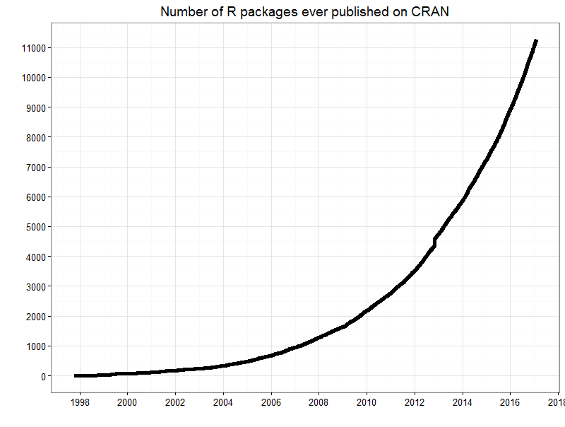
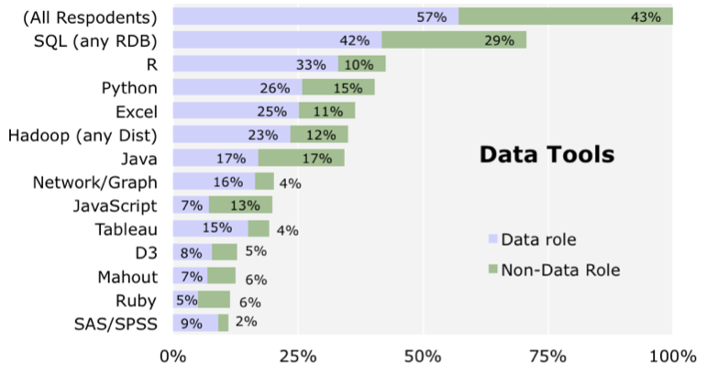
Why R?
Increasing in Popularity (especially in academia)
User contributions significantly increased over the last decade
http://blog.revolutionanalytics.com/2014/01/in-data-scientist-survey-r-is-the-most-used-tool-other-than-databases.html
http://blog.revolutionanalytics.com/2016/03/16-years-of-r-history.html

Slide 36
ggplot2 vs. base R Plots
Ggplot2 is a package created by Hadley Wickham designed to follow the grammar of graphics.
Although not included in Base R, it is very recognizable and widely used
Both work well and have their respective advantages and disadvantages
This is beyond the scope of this workshop
http://varianceexplained.org/r/why-I-use-ggplot2/
https://flowingdata.com/2016/03/22/comparing-ggplot2-and-r-base-graphics/

Slide 37
Grammar of Graphics
Originated by Leland Wilkinson, simplified by Hadley Wickham and others.
Data – The raw materials of your visualization
Layers – What you actually see on the plot (plots,lines,etc.)
Scales – Maps the data to grpahical output
Coordinates – The visualization’s perspective (normally a grid)
Faceting – Provides details into the data (analoguous to pivot tables)
Themes – Control the details of the display (color scheme, fonts)
http://vita.had.co.nz/papers/layered-grammar.pdf
Notes:
Alison

Slide 38
The Basics
Data – The raw materials of your visualization
Aesthetics – The mapping of your data to the visualization
X-axis is age
Y-axis is survival
Layers – Any visualization requires at least one layer and in ggplot2 these are typically the geoms.
Example a barchart is geom_bar()

Slide 39
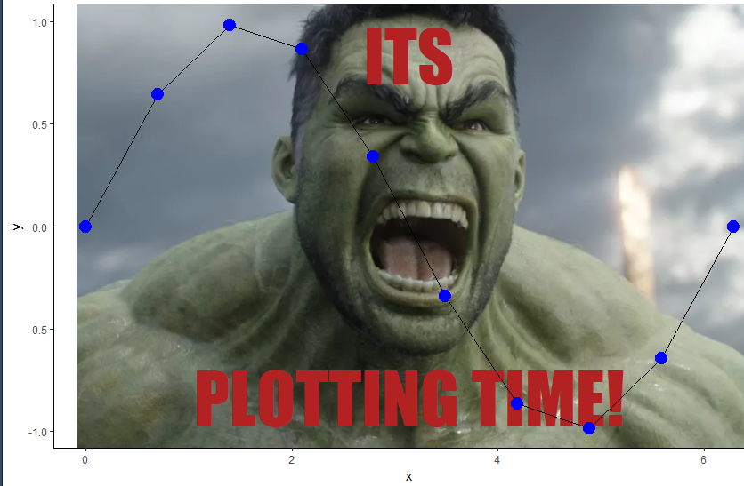
Questions?

Slide 40
Contact the Visualization Laboratory
Email: AskData@uc.edu
Web: https://guides.libraries.uc.edu/VizLab
Visit: 240 Braunstein Hall (Geology-Math-Physics Library)
Consultation Hours
Tuesdays -10:00am-12:00pm
Thursdays: 2:00pm- 4:00pm

